Slide 1

Real Estate Business Analysis Capstone Project: Uncovering Trends in HDB Resale Flats
Data-Driven Insights for Strategic Decision-Making
Raymond
Date
Course/Program: Real Estate Business Analysis Initiative
Notes:
Good morning/afternoon everyone, and welcome. Today, we'll be presenting our capstone project for the Real Estate Business Analysis initiative.
Our focus is on the HDB resale flat market, a crucial segment of Singapore's housing landscape. We aim to provide data-driven insights that can inform strategic decision-making within this sector.

Slide 2
Presentation Agenda
• Project Overview & Objectives
• Data Sources & Cleaning Process
• Analytical Findings: Key Trends & Insights
• Dashboard Walkthrough & Business Implications
• Recommendations & Future Work
• Q&A
Notes:
Here's a brief overview of what we'll cover today. We'll start by setting the stage with our project's objectives, then dive into the data – where it came from and how we prepared it.
The core of our presentation will be the analytical findings and a walkthrough of our interactive dashboard, demonstrating how these insights translate into actionable business implications. Finally, we'll discuss our recommendations and open the floor for your questions.

Slide 3
Project Overview: Decoding the HDB Resale Market
• Context: Importance of HDB resale market in Singapore housing.
• Problem Statement: Lack of actionable insights from raw data.
• Core Objective: Analyze HDB resale data to identify trends and drivers.
Key Questions:
- What are the prevailing price trends?
- How do prices vary by flat type, town, lease?
- What are indicators of demand/supply?
- Where are the investment hotspots?
Notes:
Our project centers on the HDB resale market, which plays a vital role in Singapore's housing accessibility and affordability. Despite the wealth of transaction data available, it's often challenging to extract clear, actionable intelligence from it.
Our main objective was to bridge this gap: to transform raw HDB resale transaction data into meaningful insights.

Slide 4
Data Sources: Foundation of Our Analysis
• Source: hdb_resale_flats.csv (e.g., Data.gov.sg)
• Coverage: Historical resale records from [Start Date] to [End Date]
• Key Fields: month, town, flat_type, floor_area_sqm, resale_price, lease info
• Data Size: X rows, Y columns
• Tools: Python, Power BI
Notes:
The foundation of our analysis is the hdb_resale_flats dataset, primarily sourced from Data.gov.sg. It provides historical transaction records, invaluable for understanding market behavior.
We used Python for scripting and Power BI for modeling.

Slide 5
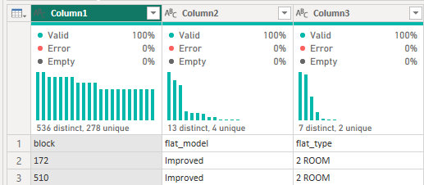
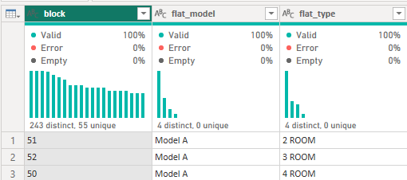
Data Cleaning & Pre-processing: Ensuring Data Integrity
• Missing Values: Addressed via median/mode imputation or deletion
• Outliers: Treated using IQR or domain logic
• Duplicates: Removed exact duplicates
• Data Types: Standardized dates, numbers, and text
Before
After
Notes:
Data quality is paramount. We handled missing values, addressed outliers through methods like IQR, and removed duplicates. Data types were standardized to support analysis.

Slide 6
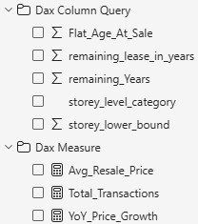
Feature Engineering & DAX: Enhancing Analytical Depth
New Fields:
• Price_Per_SQM
• Lease_Remaining_Years
• Flat_Age_At_Sale
Key Measures:
• Avg_Resale_Price
• Total_Transactions
• YoY_Price_Growth
Notes:
We enriched the dataset with calculated fields like Price per SQM, Remaining Lease Years, and Flat Age. These allowed for better trend analysis and segmentation. DAX in Power BI helped compute dynamic metrics.

Slide 7
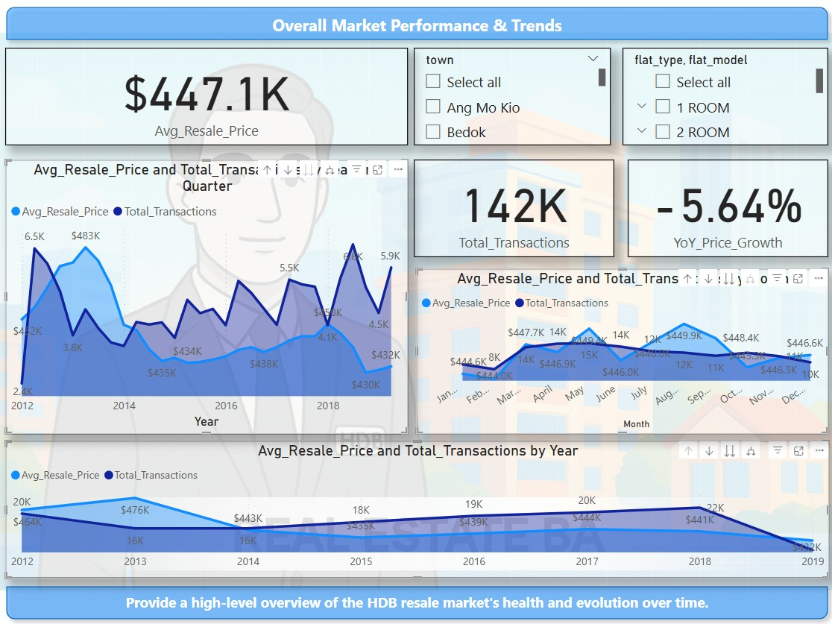
Analytical Findings: Resilient Market Growth
Notes:
Our analysis shows consistent growth in resale prices and stable transaction volumes. This suggests a resilient and healthy HDB resale market.

Slide 8
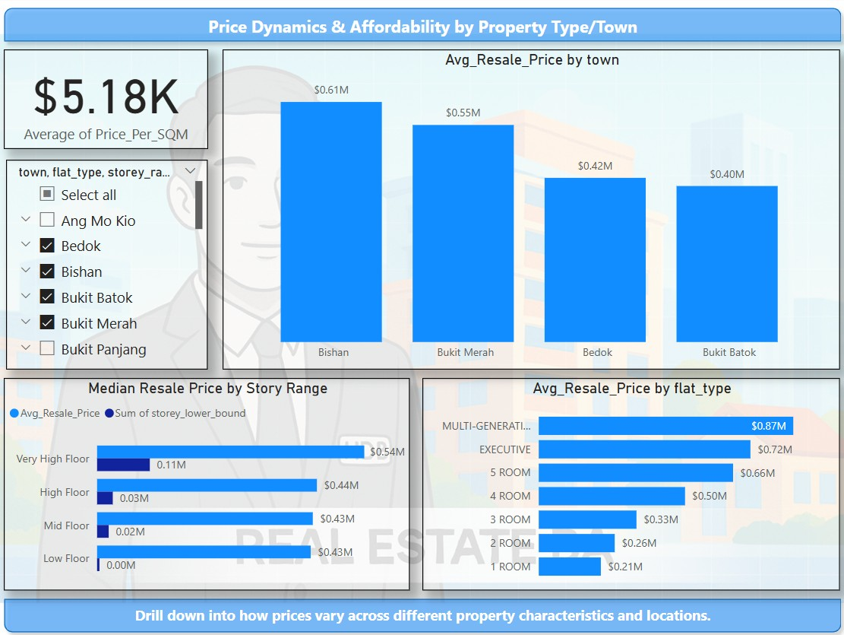
Price Dynamics: Flat Type & Locational Premiums
Notes:
There are clear price differences by flat type and town. Central, mature towns command premiums due to location, amenities, and infrastructure.

Slide 9
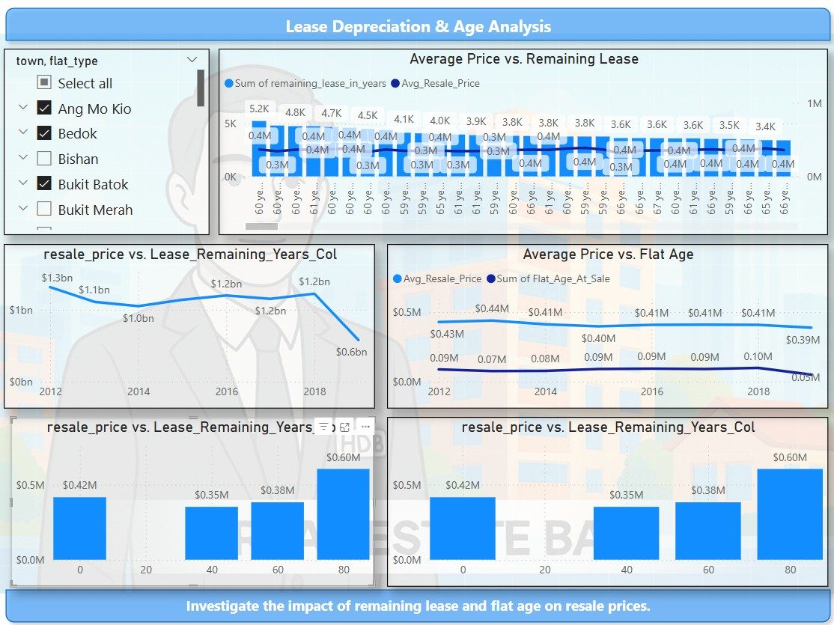
Lease Depreciation: Understanding Its Influence
Notes:
Lease remaining has a notable effect on resale price. Prices drop significantly once lease falls below 60 years, affecting asset value and resale potential.

Slide 10
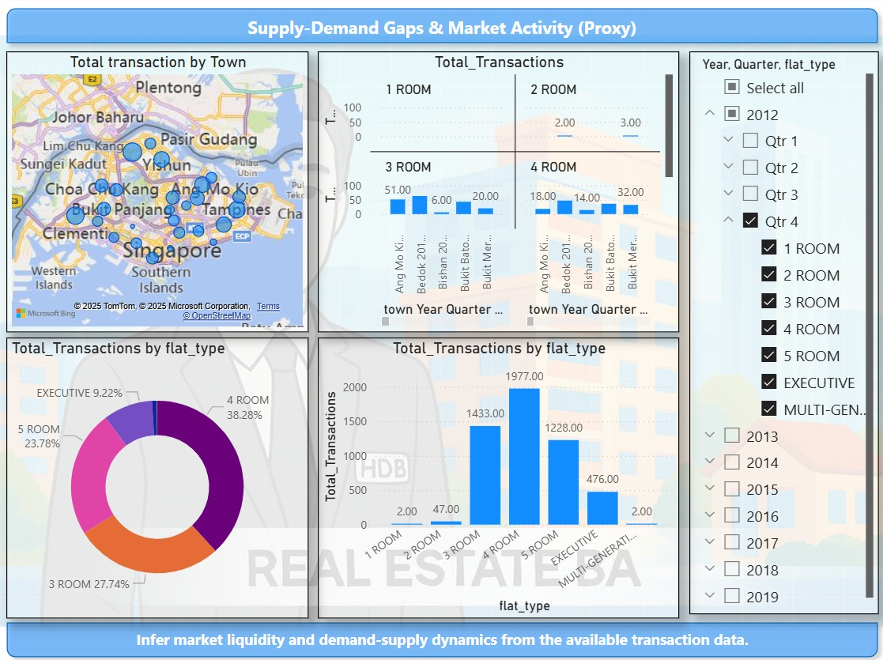
Market Activity: Identifying Demand Hotspots
Notes:
We used transaction volumes to infer demand. Towns with consistently high activity suggest hotspots of buyer interest and fast-moving inventory.

Slide 11
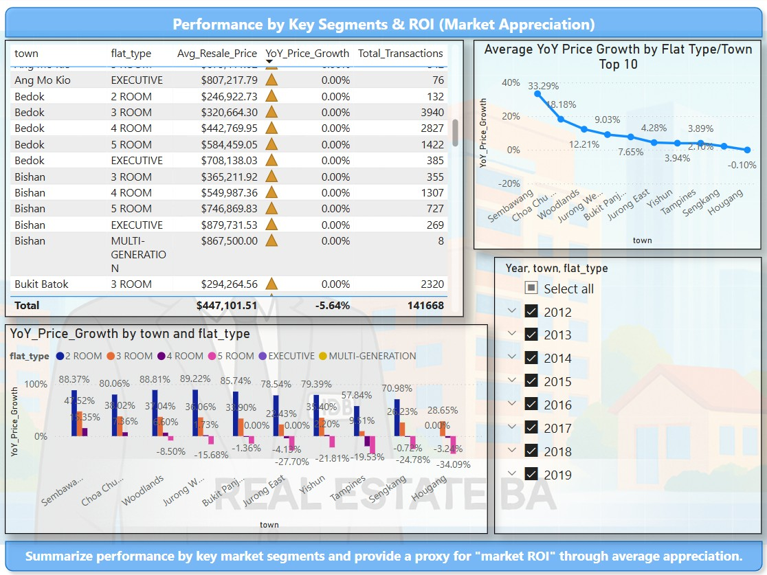
Dashboard Walkthrough: Interactive Insights in Action
Notes:
Our Power BI dashboard lets users explore trends interactively. It features slicers, drill-downs, and tooltips to answer business questions on-the-fly.

Slide 12
Business Implications & Strategic Recommendations
• Investors: Focus on growth towns, consider lease length
• Agents: Market in high-demand towns, educate on lease
• Policy Makers: Monitor town-level trends for affordability
Notes:
Based on our insights, different stakeholders can take strategic actions. For example, investors can seek undervalued areas with growth; agents can target hot areas; and policymakers can track affordability.

Slide 13
Limitations & Future Enhancements
Current:
• Transaction-only data
• No demographics or macro factors
Future:
• Add economic indicators, listing data
• Predictive modeling
• Geospatial & sentiment analysis
Notes:
We acknowledge limitations like lack of economic context and demographics. Future work can expand into predictive models and integrate external data sources for richer insights.

Slide 14
Q&A: Your Questions, Our Insights
We welcome your questions and feedback.
Notes:
Thank you for your attention. We’re ready to take your questions on our findings, dashboard, or recommendations.

Slide 15
Thank You!
Your Name(s)
Email | LinkedIn
We appreciate your time and attention.
Notes:
Once again, thank you for your time and attention today. Please feel free to reach out if you’d like to discuss this project further.

